Slide 2
The Power of Self-Managing Clusters
Sahithi Ayloo, VMware
Arun Krishnakumar, VMware
Notes:
Good morning everyone!
Welcome to our session - The power of Self-Managing clusters.
My name is Sahithi, I am an engineer from VMware. My coworker, Arun Krishnakumar couldn’t join due to personal reasons, but he will be presenting through a recording.
What is this talk going to be about?
We all know LCM of K8s clusters is a very challenging task, especially when managing 100’s or 1000’s of K8s clusters in gigantic cloud environments. And we also know that, now a days, Cluster API has become a defacto standard for life cycle management of K8s clusters. It comes with lot of benefits. So, what is the problem? CAPI works very well in dedicated private clouds
In this talk we will talk about about the challenges we faced trying to fit CAPI into multitenant clouds, how we have slightly modified the standard usage pattern of CAPI, that is how we have productized the concept of "self-managing clusters" to build our Kubernetes Engine that delivers Kubernetes clusters in a self-service manner.
With that, lets get started!

Slide 3
Agenda
Introduction
Current Usage Patterns of Cluster-API
Issues with the usage patterns
Kubernetes Engine via Self-Managing Clusters
Fleet Management
Notes:
Agenda, For the first one-third of the presentation we will be building the problem statement around CAPI usage in multitenant cloud environment and after that we will be going over how self-managing clusters solved our needs.
I will do the introduction and then Arun will go over the CAPI usage patterns and issues around it. After that, we will describe how we built a Kubernetes Engine with self-managing cluster. We will wrap it up with how we solved fleet management in our design.

Slide 4




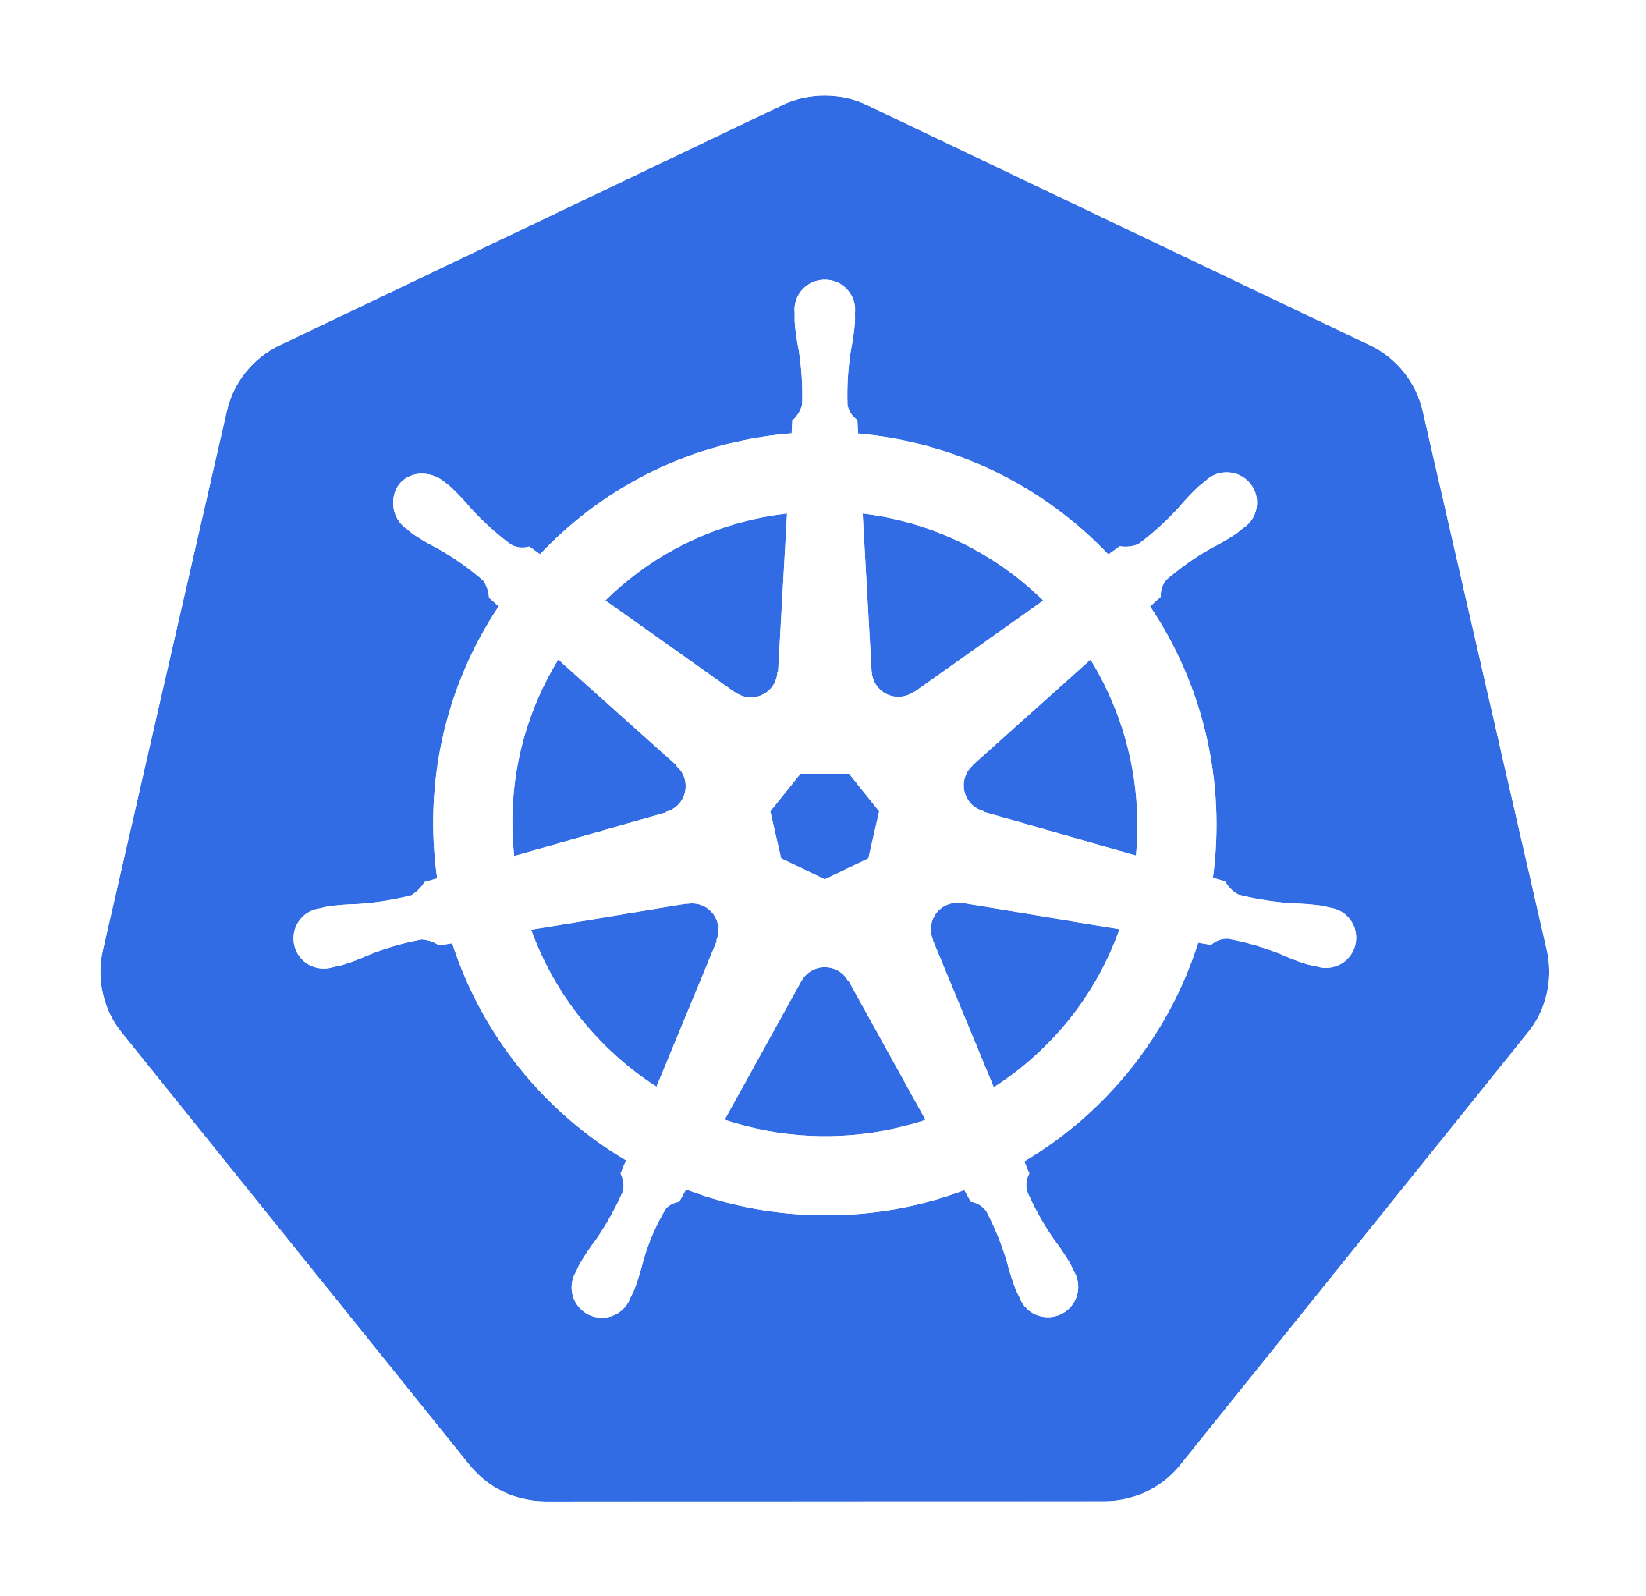
Multitenant Cloud – VMware Cloud Director
Cloud provider
Tenant Org1 Users
VMware Cloud Director
Tenant Org2 Users
Tenant Org1
Tenant Org2
Personas
Cloud Admin/Provider
Tenant Org Admin
Tenant Org User
Tenant here is an Enterprise level Organization with thousands of users
Notes:
Multitenant Cloud Diagram Slide - before we delve into the details, I want to give an overview on our multitenant cloud architecture to set the context for the problem statement. This big cloud here is IaaS platform like rackspace and here is the Cloud Provider. The tenants he/she is selling the infra is NOT to end individual users but Enterprise level organizations. Here are the personas we will be using in this session. Describe Tenant admin. Note that these little tenant orgs are isolated from each other in terms of compute, networking and storage and they have their own strict boundaries. Thousands of organizations with each having thousand of users
Now, tenant user1 of the org1 requests for a K8s cluster of a certain shape and size by clicking button somewhere and the cluster gets delivered to the end user. That's what we did - we built a Kubernetes engine that delivers clusters in a self-service manner on a multi tenant cloud with ClusterAPI at its core.

Slide 5
Goals and Observations for our Multitenant Cloud
Goals
Deliver Kubernetes Clusters in a Self-service manner.
User asks for a Kubernetes cluster and the system must deliver it.
Observations
Personas (Cloud admin, Tenant Organization Admin) are not necessarily Cluster API savvy.
Do not expect users to know the internals of Cluster API.
Notes:
@Sahithi: Can we change Assumptions to Observations

Slide 6
Background on Cluster API
Cluster API, a Kubernetes SIG project simplifies the LCM of the clusters, solves this problem to an extent by outsourcing the burden to “management clusters”, which are supposed to manage their children workload clusters.
Workload cluster
Kubernetes cluster
Create cluster
CAPI + CAPVCD
Workload cluster
Resize, Upgrade, Delete
* CAPVCD – CAPI Infrastructure provider for VMware Cloud Director
Notes:
Background on Cluster API: ooWe expect the audience to have a fair understanding on what Cluster API is. I will briefly touch up on it. CAPI is a K8s SIGS project that simplifies LCM of K8s clusters. It offers lot of benefits in terms of simplified usage, ease of development, faster feature delivery rate, and most importantly the ecosystem behind it.
CAPI expects a parent cluster to be already present in order to create clusters. That parent cluster with CAPI components installed is called Management cluster and the children clusters created from it are called workload clusters. There is one networking constraint I want to highlight here highlight, CAPI expects that management cluster to be able to reach the control plane endpoint of the workload clusters. Hold on to that constraint and Arun will go over how this can become a challenge in a multitenant cloud.
Another point to highlight here is the owner of the workload clusters needs to have access to management cluster to resize, upgrade their cluster.

Slide 7
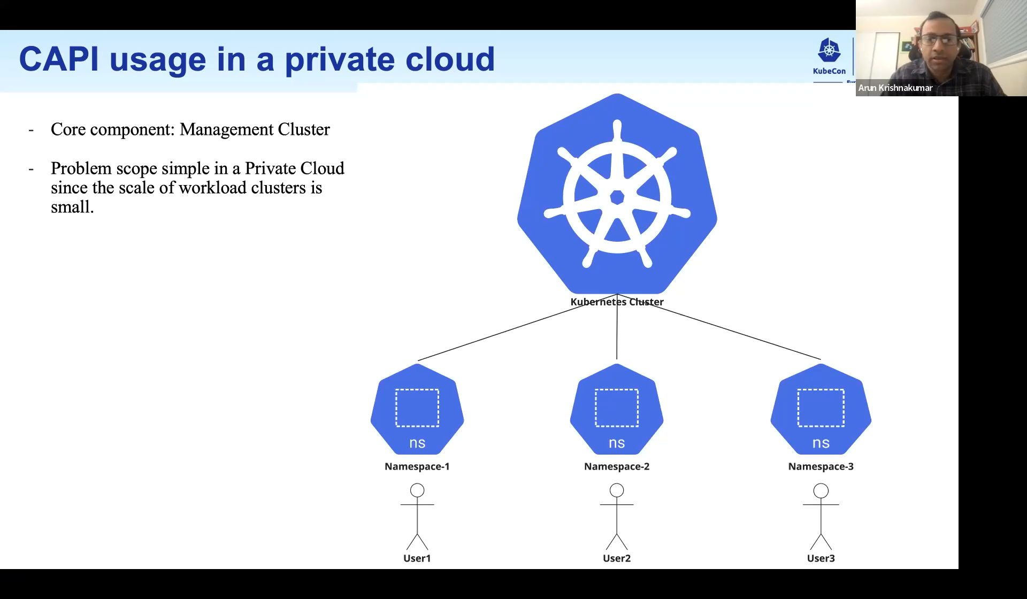
ClusterAPI Patterns
Notes:
(1m)
How does CAPI work in a private cloud?
Admin would set up a management cluster manually and is expected to LCM it manually.
Users of that cloud need some isolation and privacy in creating and managing their workload clusters.
Admin needs to do some work around user management.
HA , Upgrades,

Slide 8
CAPI usage in a private cloud
Core component: Management Cluster
Problem scope simple in a Private Cloud since the scale of workload clusters is small.
Notes:
(1m)
How does CAPI work in a private cloud?
Admin would set up a management cluster manually and is expected to LCM it manually.
Users of that cloud need some isolation and privacy in creating and managing their workload clusters.
Admin needs to do some work around user management.
HA , Upgrades,

Slide 9
Workload Cluster Creation Workflow
Ask for Management Cluster Access
Cluster Creation with VCD token as secret
Get KUBECONFIG of Workload Cluster
Notes:
(1m30s)
This is the complexity of creating a cluster. This can be automated, but there are a few aspects to note:
1. There are aspects of Management cluster discovery
2. The workflow is somewhat Kubernetes centric; Cloud Provider Administrators need to have substantial Cluster-API and Kubernetes knowledge.
3. There is an additional Cluster that needs to be managed carefully: there are version skews of Management-Cluster and Workload-Cluster compatibility.

Slide 10
CAPI usage in a Multitenant cloud
VMware Cloud Director
Problem statement changed: strict isolation, fairness and management cluster availability are table-stakes.
New Persona for Management Cluster LCM
This persona ensures that each tenant / user is isolated from other tenants / users.
This persona also ensures continuous availability and LCM of Management clusters
Tenant Org1 Users
Tenant Org2 Users
Cloud provider
Management Clusters
Management Cluster Admin
Tenant Org1
Tenant Org2
Notes:
(1 min)
TODO
Multitenant Clouds are Production Clouds with different requirements
(Requirements need to be from Cloud Provider requirement)

Slide 11
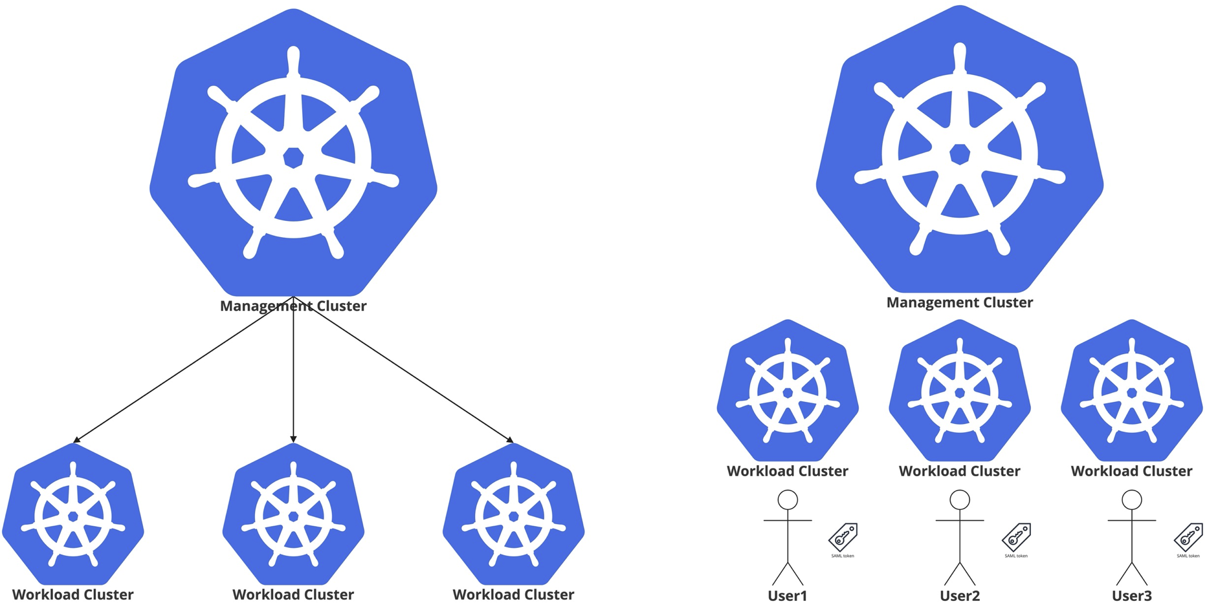
CAPI usage in a Multitenant Cloud
Management Cluster is an SPoF?
Isolation of workload cluster objects is using namespaces
Notes:
(1m)
How does CAPI work in a private cloud?
Admin would set up a management cluster manually and is expected to LCM it manually.
Users of that cloud need some isolation and privacy in creating and managing their workload clusters.
Admin needs to do some work around user management.
HA , Upgrades,

Slide 12
CAPI usage in a Multitenant Cloud
Management Cluster is an SPoF? HA, Backup/Restore etc. needed
Isolation of workload cluster objects is using namespaces
Notes:
(1m)
How does CAPI work in a private cloud?
Admin would set up a management cluster manually and is expected to LCM it manually.
Users of that cloud need some isolation and privacy in creating and managing their workload clusters.
Admin needs to do some work around user management.
HA , Upgrades,

Slide 13
Management cluster Patterns: Single Management Cluster
One Management cluster to rule them all!
Simple pattern which has a single overhead
Notes:
(1 min)
We see two common patterns in production scenarios with Cluster API. This is one common and obvious pattern: One Management Cluster to rule them all!
Fairness and Quota: by other means
Resource Management: complex, especially when multiple cluster autoscalers are involved
SPoF: Mgmt Cluster needs to be highly fault-tolerant: HA, Backup / Restore, ZDT
Talk about networking constraint

Slide 14
Management cluster Patterns: Single Management Cluster
However:
Strict network isolation across tenants?
Fairness and Quota?
Resources management?
Management Cluster Availability?
Tenants Orgs need to trust a Management Cluster outside their tenancy
Notes:
(1 min)
We see two common patterns in production scenarios with Cluster API. This is one common and obvious pattern: One Management Cluster to rule them all!
Fairness and Quota: by other means
Resource Management: complex, especially when multiple cluster autoscalers are involved
SPoF: Mgmt Cluster needs to be highly fault-tolerant: HA, Backup / Restore, ZDT
Talk about networking constraint

Slide 15
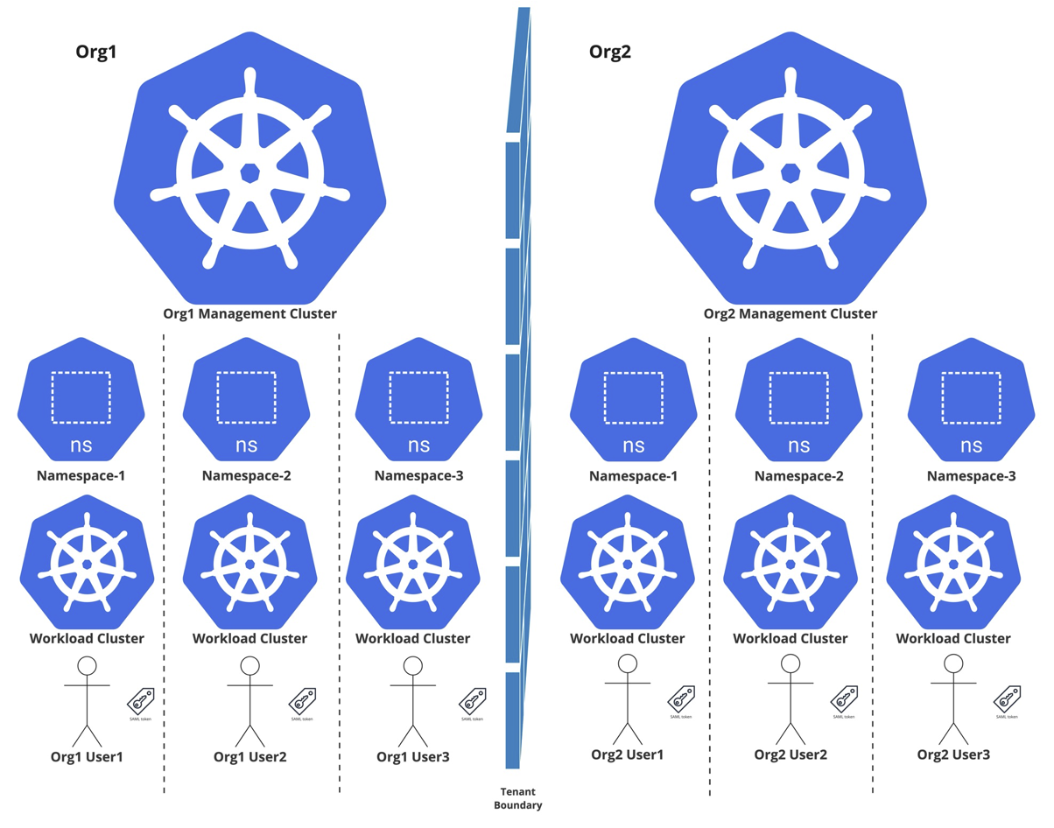
Management cluster Patterns: Multiple Management Clusters
Obvious solution: each tenant has its own Management Cluster
Tenants do not need to trust an external Management Cluster
More flexibility in cluster shape: applications, CRS etc. can be defined by different Management Clusters
Overhead of Management Cluster is delegated to individual Tenants
Strict Isolation available at tenant level
Notes:
(1 min)
Talk about Problem scale - (about the fact that each tenant is forced to have a persona that knows CAPI in and out, and that there can be 1000s of tenants, each with a management cluster)
Current VMware cloud providers / tenant administrators are not as Kubernetes savvy as CAPI requires.
Also talk about handover to Sahithi etc.

Slide 16
Management cluster Patterns: Multiple Management Clusters
However:
Scale: Managing 1000s of Management Clusters with at least one Management Cluster Persona per Tenant.
Strict Isolation at user-level?
Management Cluster is still a SPoF (per tenant)
Notes:
(1 min)
Talk about Problem scale - (about the fact that each tenant is forced to have a persona that knows CAPI in and out, and that there can be 1000s of tenants, each with a management cluster)
Current VMware cloud providers / tenant administrators are not as Kubernetes savvy as CAPI requires.
per tenant: needs HA, Backup / Restore, ZDT
Also talk about handover to Sahithi etc.

Slide 17
Quick Recap
CAPI Usage Patterns
Private Cloud (Single Management cluster for all Workload Clusters)
Multitenant Cloud (Multiple (per tenant-org) Management Cluster(s))
Challenges
User level multitenancy within a management cluster
HA, Backup/Restore, Zero Downtime Upgrades of Management Cluster(s)
Life cycle management of Management cluster(s) themselves
Hierarchical dependency on Management cluster for workload cluster to exist
The requirement of Cloud Provider and Tenant Org Admin Personas to be Cluster API Savvy.
Cluster-Autoscaler and other Cluster management techniques become complex.
Revised Problem Statement for Our Cloud – VMware Cloud Director
Build Kubernetes Engine that delivers Kubernetes Clusters in a self-service manner with Cluster API at its core.
Avoid the burden of managing Management Clusters.
Reduce the need for Cloud admin and Tenant admins to be Cluster API savvy.
Notes:
Quick Recap:
Thanks Arun. Let us do a quick recap on what has been discussed so far.
We discussed
Number1, the CAPI usage in a private cloud. It works pretty well in the case of single management cluster handling workload clusters.
Number2, the CAPI usage in a multitenant cloud. We noticed scale issues, the management of management clusters (1000 orgs), user-level management, every tenant-admin needs to be CAPI savvy, user-level management and other problems
Revised problem statement:
Build K8s engine with CAPI at its core to deliver K8 clusters in a self-service manner
Avoid burden of managing management clusters.
Do not introduce a new paint point for tenant org administrators to be CAPI savvy.
If some of you are wondering why use cluster API and resort to something else. We do want to use Cluster API and all the benefits it brings and the ecosystem behind it.
Okay, let us move onto the next proposal of No management cluster.

Slide 18
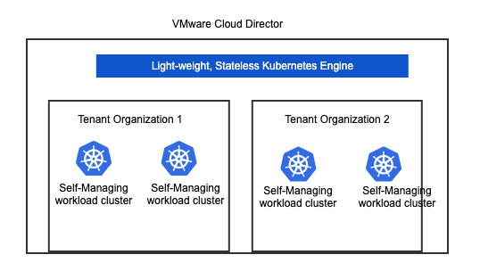
Management Cluster Patterns: No Management Clusters?
A light-weight Kubernetes Engine manufacturing CAPI based clusters
All of the following issues will disappear
Placement of the management cluster?
Management of multiple Management clusters
HA, RBAC, Upgrades, Back up of the management cluster(s)
K8s version skew between management and workload clusters
Single point of failure considerations
User-level multitenancy within a Management cluster
More..
Notes:
No Management Clusters:
Imagine there is no Management cluster layer at all. Neither at the cloud layer nor at the individual tenant organization layer. Instead, build a simple program, a light-weight, stateless K8s engine, which automates the manufacturing process of K8s clusters using CAPI, but makes them a bit more capable enough to manage themselves. They can resize and upgrade themselves.
All of these problems that we have discussed so far will disappear.
Before we go deep into how K8s engine manufactures these clusters, let double-click on what a self-managing cluster is.

Slide 19
What is a Self-Managing Cluster?
Self-managing cluster
Management cluster
Workload cluster
CAPI + CAPVCD
CAPI + CAPVCD
clusterctl move
Workload cluster records in etcd
(Cluster, Machine, VCDCluster, VCDMachine etc.)
Own cluster records in etcd
(Cluster, Machine, VCDCluster, VCDMachine etc.)
Labelled objects move to
Workload Cluster Operations
Create: kubectl apply –f create_cluster.yaml
Resize: kubectl apply –f resize_cluster.yaml
Upgrade: kubectl apply –f upgrade_cluster.yaml
Workload Cluster Operations
Resize: kubectl apply –f resize_cluster.yaml
Upgrade: kubectl apply –f upgrade_cluster.yaml
* Clusterctl is a tool CAPI provides to setup and manage the management cluster
Notes:
What we have here is traditional management to workload cluster hierarchy. This is the management cluster with Cluster API components installed. User would come and create the workload cluster and once the cluster is created, they can resize and upgrade commands against the management cluster and the resultant effect takes place here. Note that workload cluster records are stored in the etcd database of the management cluster.
Once we run clusterctl move, all these records of the workload cluster are moved from here to here. CAPI sitting in the workload cluster now can see its own records and thats what makes it capable to operate on itself. All further update operations can be done directly against the workload cluster. We no longer need the management cluster as well.
Self-managing cluster is not something we came up with. CAPI already supports it. The novelty here lies in the fact that we have productized this concept to deliver self-managing K8s clusters in gigantic multitenant cloud environments in a self-service manner.

Slide 20
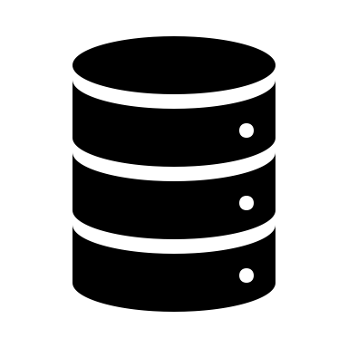
Cluster API as a Service on a Multitenant Cloud
CAPI YAML
kind: KubeadmControlPlane
spec:
replicas: 3
version: 1.22.9
---
kind: MachineDeployment
spec:
replicas: 5
---
kind: VCDCluster
spec:
orgName: org1
For Cluster Deletion, the same process as cluster creation
needs to be repeated
Cloud provider
K
8S
ENGINE
Self-Managing Cluster
Tenant-Org2
L4/L7 Load Balancer
CAPI
CNI
Control plane VMs
CPI
Tenant-Org1
CSI
Worker VMs
Custom Operator
Self-managing cluster
Self-managing cluster
Tenant Org1 user
Self-managing
Kubernetes cluster
Workload cluster
Bootstrap cluster (ephemeral management cluster)
Self-managing cluster
*KIND is a tool to run local Kubernetes clusters using docker
container as nodes
Notes:
Cloud Picture: Now that we know what self-managing clusters are, let us see how end to end workflow looks like in action.
Go through the diagram.
Next, let us take a deeper look into the manufacturing process of the self-managing clusters.

Slide 21
Updates, Upgrades and Fleet Management
Cluster Management - Updates and Upgrades
As a CAPI savvy tenant user, I can access the cluster directly to run kubectl apply –f resize_cluster.yaml
As a novice Kubernetes user, I want to click the UI buttons to resize or upgrade the cluster.
Application Management
As a cloud provider, how do I facilitate the upgrade of CAPI, CPI, CNI, CSI on all the workload clusters?
As a cloud provider, how do I install certain applications on the clusters?
As a tenant user, how do I install my own applications on the clusters?
Policy Management
As a cloud provider, how do I apply network policies on a set of clusters? (or) set a container registry on a group of clusters?
Notes:
Let us dig a bit more deeper into how fleet management operations can be carried out.
Once the cluster is ready, a CAPI savvy user can directly access the cluster and run resize and upgrade commands. No issues there.
What about novice user?
For all of this to happen, there needs to be automated way to take the user intent and propagate it down to the cluster, without user having to manually intervene, let us see how.

Slide 22
Updates, Upgrades and Fleet Management
How to propagate the User Intent to the target cluster?
Push model: Kubernetes Engine pushes the user/admin intent to the Kubernetes cluster
Pull model: Custom Operator inside the Kubernetes cluster pulls the user intent and applies it.
Multitenant Cloud (VMware Cloud Director)
Kubernetes Engine
Tenant Org1
CAPI YAML
kind: KubeadmControlPlane
spec:
replicas: 3
version: 1.22.9
---
kind: MachineDeployment:
spec:
replicase:10
PUSH
Tenant Org 2
PUSH model does not work well in the case of strictly isolated multitenant environments
Notes:
There are

Slide 23
Updates, Upgrades and Fleet Management
How to propagate the User Intent to the target cluster?
Push model: Kubernetes Engine pushes the user/admin intent to the Kubernetes cluster
Pull model: Custom Operator inside the Kubernetes cluster subscribes to the various forms of user intent and periodically applies them onto itself.
Multitenant Cloud (VMware Cloud Director)
CAPI YAML
kind: KubeadmControlPlane
spec:
replicas: 3
version: 1.22.9
---
kind: MachineDeployment:
spec:
replicase:10
YAML(s) to install admin-recommended packages
Self-Managing Cluster
Custom Operator
L4/L7 Load Balancer
CAPI
Pull Model: Custom operator works well even in strictly isolated multitenant environments
Control plane VMs
CNI
CPI
Worker VMs
CSI
Notes:
Updates, Upgrades and Fleet Management
Let us say we have a fully functional self-managing cluster hosting modern apps, now user wants to resize, upgrade the K8s version on it.
As I mentioned, CAPI savvy user can always go and run commands against it directly. However, there can be a case where the cluster is inaccessible from where the user is (or) user could be a novice user and wants to use UI (or) Cloud provider wants to do a fleet management operation on all the clusters of the cloud - upgrade CAPI version.
Operator to subscribe the resources
This operator can be installed at the time of cluster creation process we described earlier.

Slide 24
Recap: Benefits of Self-Managing Clusters
Reduced Infrastructure costs
No need to worry about the infrastructure resource management for the Management clusters.
Less cost to the tenant organizations.
No need to worry about HA, Backup/restore of the multiple management clusters in a multitenant cloud.
Reduced Operational costs
No need for a CAPI savvy persona (cloud provider/tenant org admin) to exist.
No need to worry about the user-level multitenancy within a given Management cluster.
No need to worry about the Kubernetes version skews between Management and workload clusters. User has the choice of not being part of the fleet.
Target workload clusters do not have to depend on the availability of another Management cluster.
Notes:
Benefits of Self-Managing Clusters - Spend more time here
A) no need to worry about who has to pay for these management clusters.
B) HA, backup/restore fails badly - repercussions are very dramatic.
There are so many things to worry about. If we choose to go by the route of managemanetcluster hierarchichal structure, at some point we will have to consider automating the management of management cluster, which can turn out to be a
Multitenant logging: Another sweet hidden benefit that we get from this architecture is Multitenant logging. Imagine a simple use case of 100 clusters being managed by a single management cluster. When there is some issue with one particular cluster, the owner first needs to contact the admin of the management cluster and analyze the logs, there is lot of time, process and human aspect is involved.
Users have more control , they can have capi version
HA, backup/restor fails badly - repercussions are very dramatic.
So, what we have here is an end to end solution
Q: why can't you write your KCP (by uncommenting workload cluster reachability condition)? Features like MHC, autoscaler – they all need network connectivity
There are other features in CAPI like MHC, Autoscaler... we will be in a state where we are writing things from scrtach. We want to leverage the ecosystem and the feature rate that comes with it.
At the same time, we turned around the xisting pattern to cater to our needs very well.

Slide 25
Recap: Benefits of Self-Managing Clusters
Multitenant logging
As CAPI logs are available per individual target cluster, debuggability is much easier. The hierarchical process of information gathering is not needed any more.
An option for Custom Operator is to push the logs to Log servers for users to debug and troubleshoot.
Fleet Management
Simple Custom Operator to subscribe to the user intent, pull and apply it.
Operator can be customized further to cater to specific needs of the cloud environment.
Personas
No need for multiple personas to keep themselves up to date on the internals of Cluster API, as the CAPI knowledge is built into the Kubernetes Engine.
Notes:
The cost we paid to accomplish all of this was to write a program to automate the manufacturing of self-managing clusters and an operator to handle fleet management.
If we have to compare the cost of maintaining the management layer vs the cost to write this extra program,

Slide 26
The Power Of Self-Managing Clusters
Cloud provider
K
8S
ENGINE
Tenant-Org1
Self-managing cluster
Tenant Org1 user
Self-managing
Kubernetes cluster
Bootstrap cluster (ephemeral management cluster)
Tenant-Org2
Self-managing cluster
Notes:
This is how we satisfied all of our requirements- there is no management layer and all the baggage it brings. Every cluster is a standalone, independent and self-managing cluster. There are no CAPI admin savvy personas, Scale and security issues are solved and fleet management is figured out.
The cost we had to pay to do this is to write a program that automates the manufacturing process of self-managing clusters and an another operator to act up on fleet management operations.
If we have to compare the cost we incur with the long-term maintenance of numerous management clusters in these gigantic clouds and all the baggage it comes with, the cost of developing this design for once is almost nothing.
We have productized this and our customers are using this solution to spin up production-grade clusters.
Yea, that's the power of self-managing clusters, thank you!

Slide 27

Thank you!
Session QR Codes will be
sent via email before the event

Slide 28
Thank you!

